Slide 1
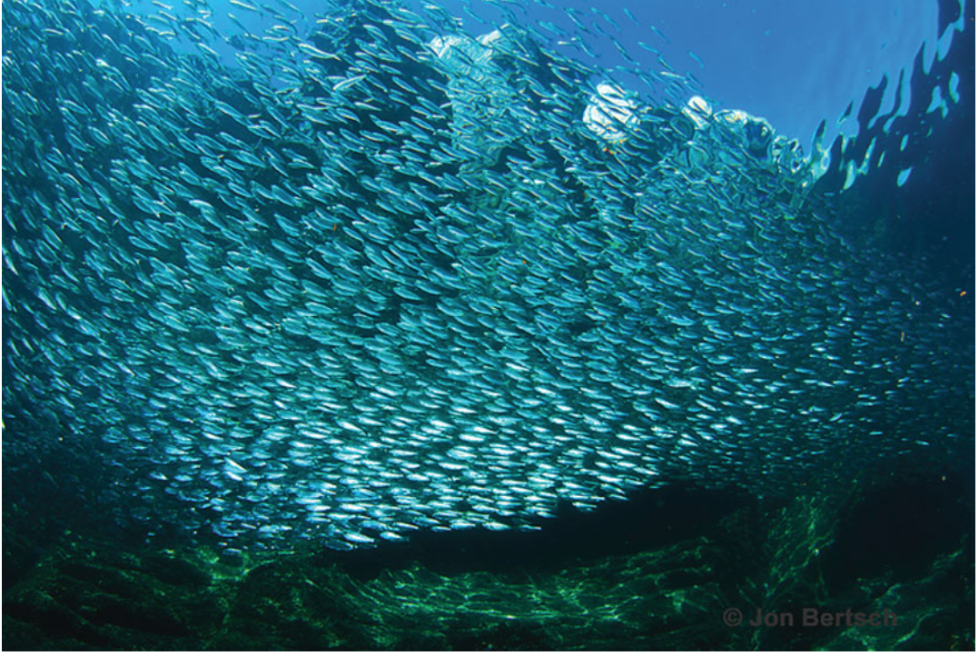
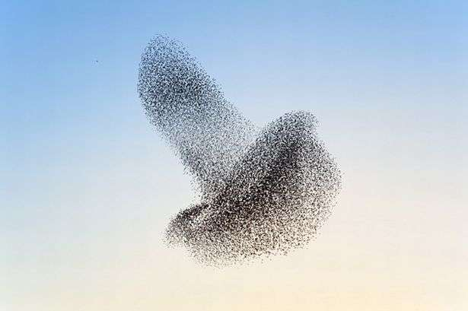
Active Matter
Flocking, Self-propelled, Chiral & Chemotactic

Slide 2
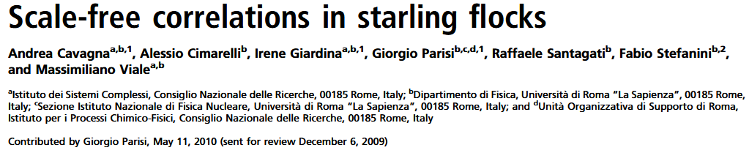
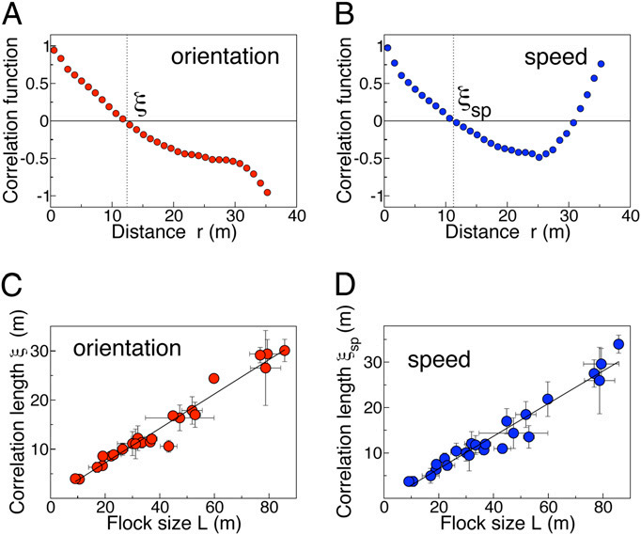
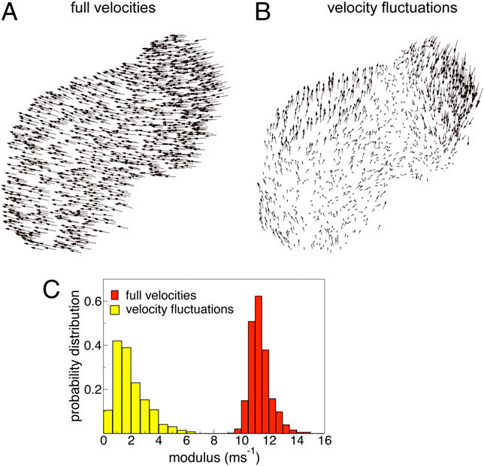
Quantification of Long-Range Correlation
A. Cavagna, A. Cimarelli, I. Giardina, G. Parisi, R. Santagati, F. Stefanini, and M. Viale, Scale-free correlations in starling flocks, Proc. Natl. Acad. Sci. U.S.A. 107, 11865 (2010).

Slide 3
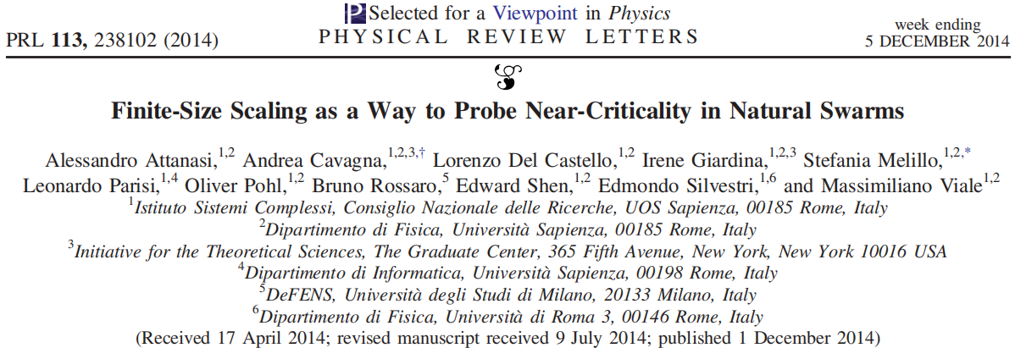
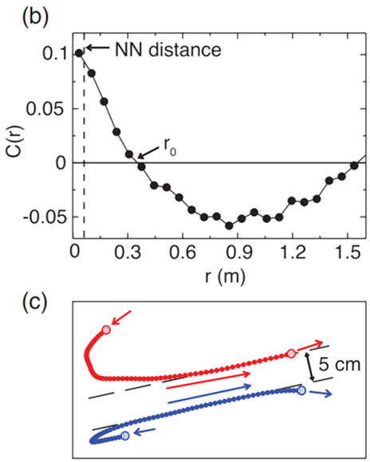
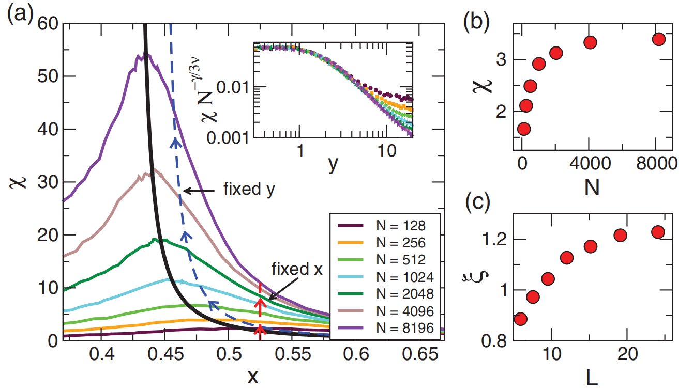
Also seen in insect swarms
A. Attanasi et al., Finite-Size Scaling as a Way to Probe Near-Criticality in Natural Swarms, Phys. Rev. Lett. 113, 238102 (2014).

Slide 4
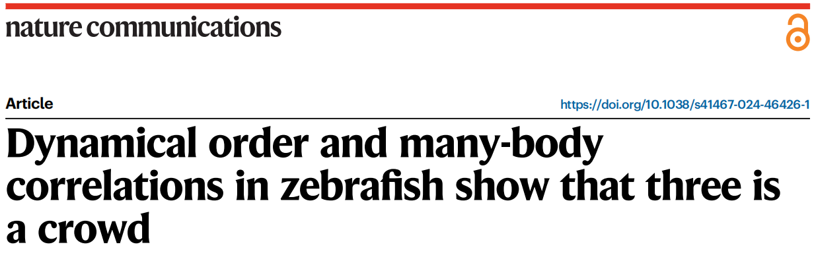
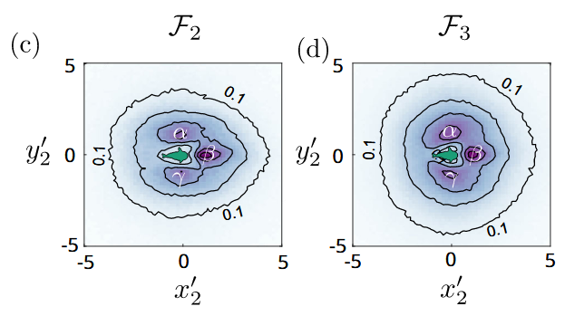
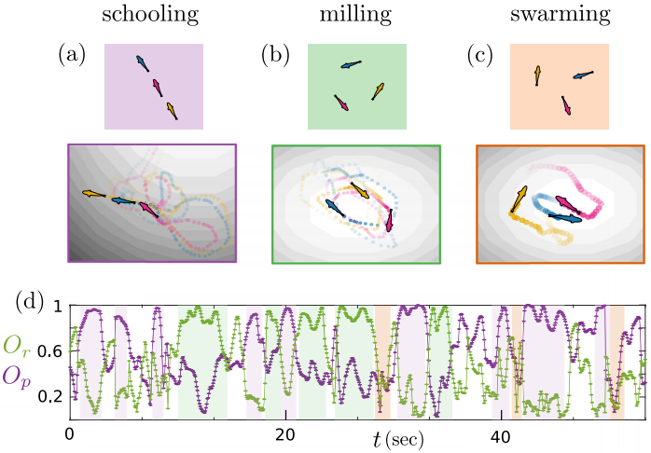
Correlation in a 2D Space
A. Zampetaki, Y. Yang, H. Löwen, and C. P. Royall, Dynamical order and many-body correlations in zebrafish show that three is a crowd, Nat Commun 15, 2591 (2024).

Slide 5
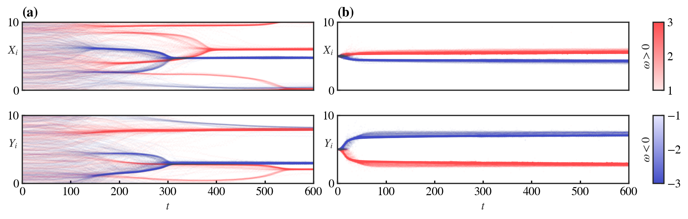
Quantification of transient behavior
Instantaneous rotation centers of CAPs :
Y. Lu et al., Self-organized circling, clustering and swarming in populations of chiral swarmalators, Chaos, Solitons & Fractals 191, 115794 (2025).

Slide 6
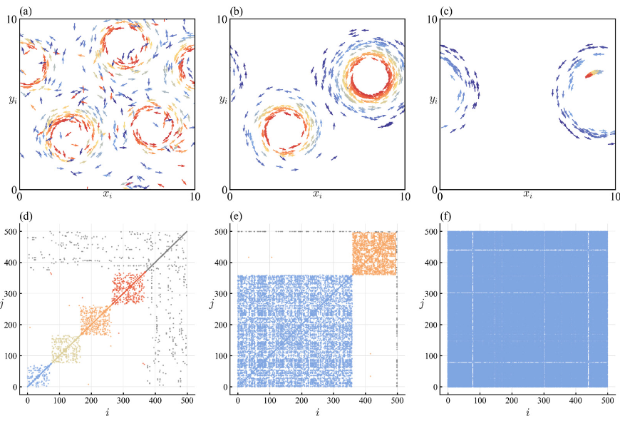
Quantification of transient behavior
The adjacency matrix A is then defined as:
Y. Lu et al., Self-organized circling, clustering and swarming in populations of chiral swarmalators, Chaos, Solitons & Fractals 191, 115794 (2025).

Slide 7
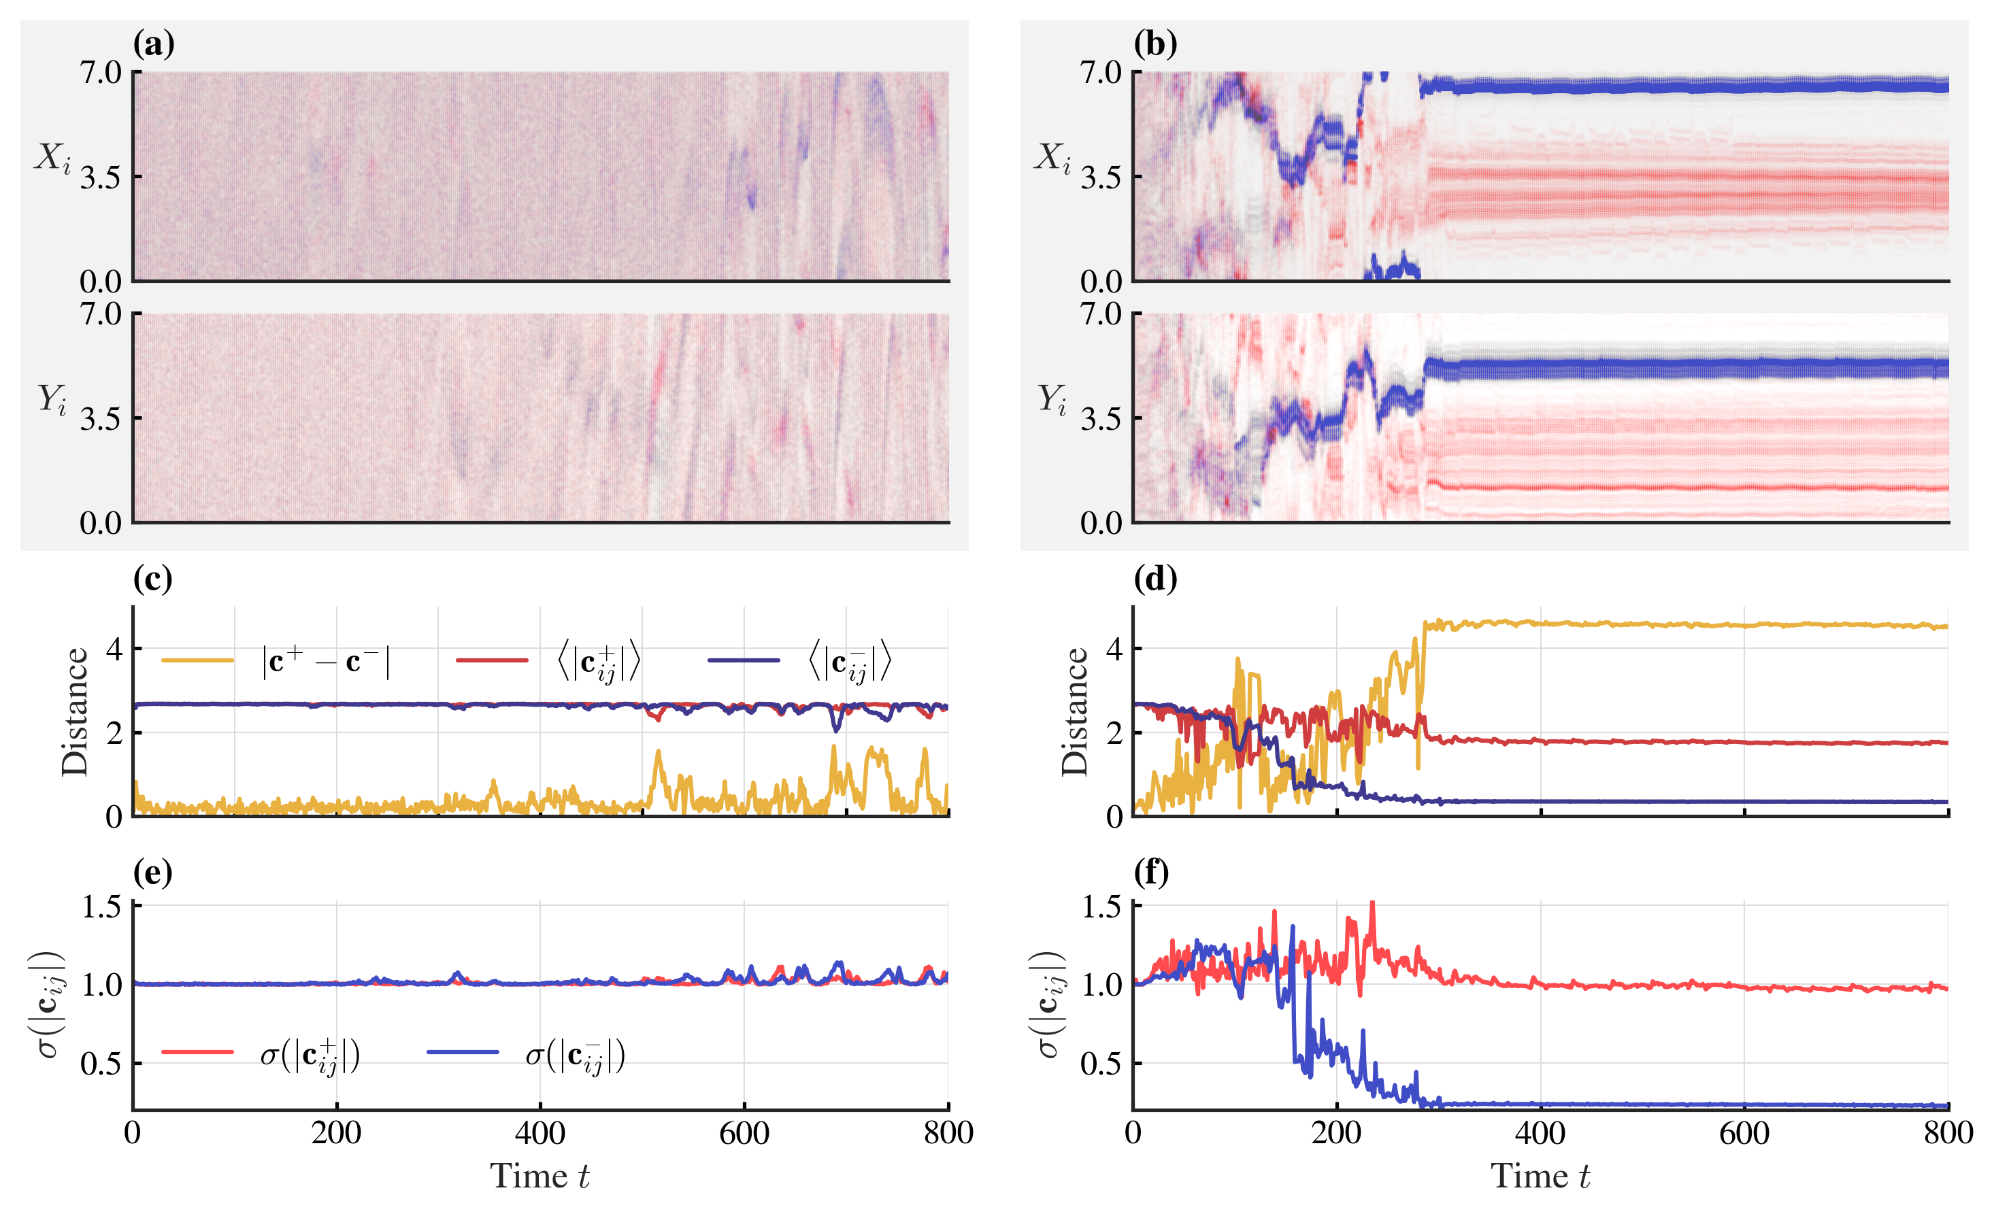
Quantification of Phase Separation
The distance between mean centers of two chiralities:
The mean distance between the centers of the same chirality:
The standard deviation of the distances between centers of the same chirality:
Y. Lu et al., Enhancing Phase Separation of Double-chiral Particles by Regulating Inter-chiral Frustration, Chin. Phys. B. (Decision in Process​)

Slide 8
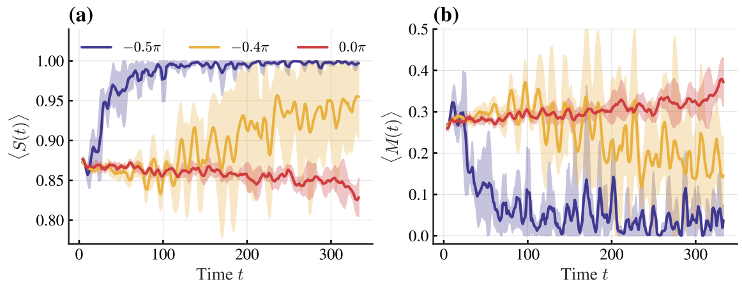
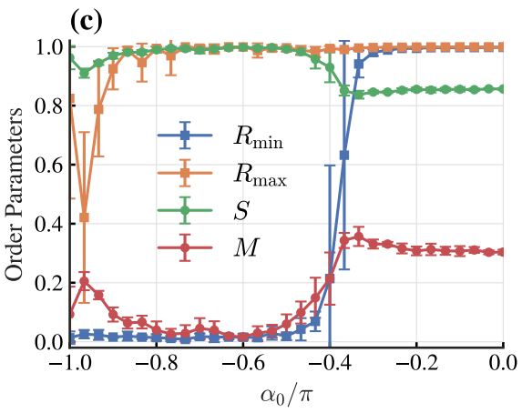
Quantification of Phase Separation
Some order parameters can be introduced to measure the chiral demixing:
where is the time rolling window and is the Heaviside step function.
Y. Lu et al., Enhancing Phase Separation of Double-chiral Particles by Regulating Inter-chiral Frustration, Chin. Phys. B. (Decision in Process​)

Slide 9
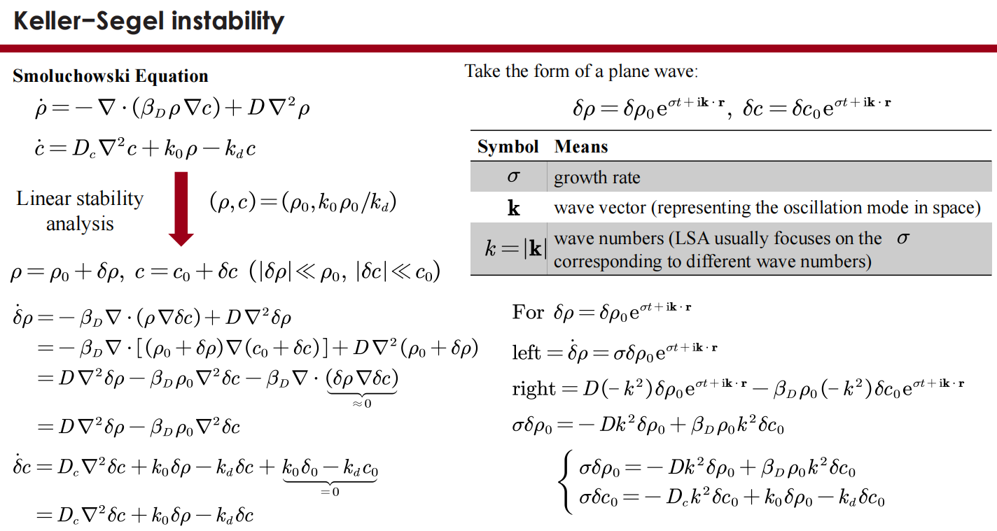
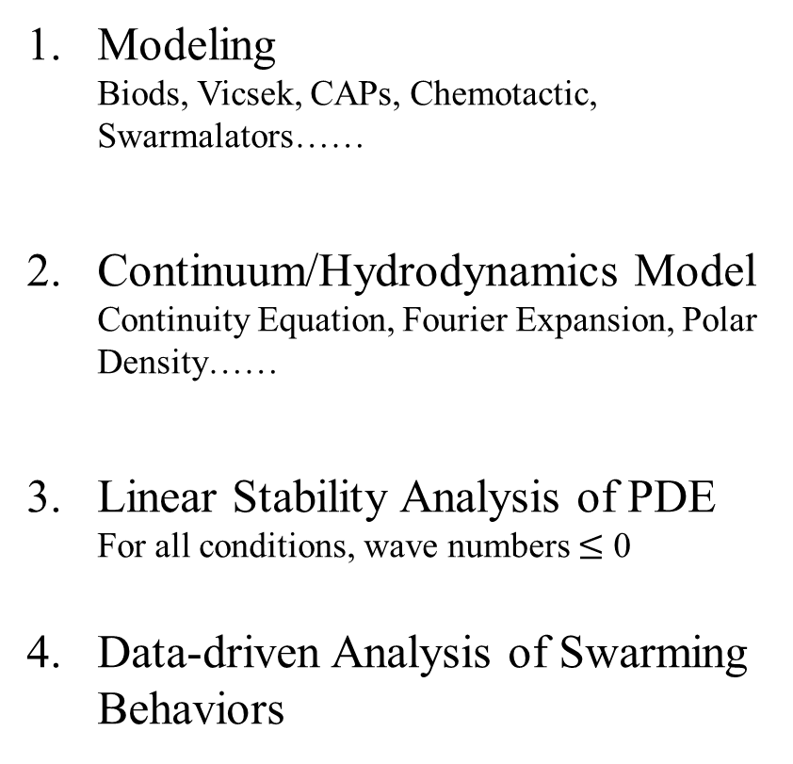
Retracing
Modeling
Biods, Vicsek, CAPs, Chemotactic, Swarmalators……
Continuum/Hydrodynamics Model
Continuity Equation, Fourier Expansion, Polar Density……
Linear Stability Analysis of PDE
For all conditions, wave numbers $≤$ 0
Data-driven Analysis of Swarming Behaviors

